Slide 1
Teaching Session Peer‑Assisted Learning (PAL) Using Padlet Group‑Based Activity & Presentation Guidelines
Course: [Insert course name] Topic: [Insert specific session topic] Facilitator: [Insert facilitator name] Date: [Insert session date]

Slide 2
Facilitator Instructions
Facilitator should:
Review all text in [square brackets]. These indicate content to edit or replace with session-specific information.
Delete this slide before sharing the deck with students.
Remove any facilitator notes included on slides. They are not for students.
Add or modify images, examples, or tables as needed to match the topic and group activity.
Ensure all placeholders ([italic bracketed text]) are reviewed, updated, or removed.

Slide 3
Session Overview
Today you will work in groups to:
Prepare and deliver a presentation
Engage in peer‑assisted learning using Padlet
Compare and contrast different approaches to [insert topic or concept]
Apply learning to [insert scenarios, case studies, or practical examples]
[Facilitator: you may add or remove activities depending on the session objectives. Ensure all bracketed text is edited or removed before sharing with students.]

Slide 4
Intended Learning Outcomes
By the end of this session, you should be able to:
[Insert Learning Outcome 1]
[Insert Learning Outcome 2]
[Insert Learning Outcome 3]
[Add any additional learning outcomes relevant to the session]

Slide 5

Group Allocations
Please modify as appropriate
There are 6 groups, each assigned one topic:
[Group 1]
[Group 2]
[Group 3]
[Group 4]
[Group 5]
[Group 6]
[Each group will work collaboratively throughout the session.

Slide 6
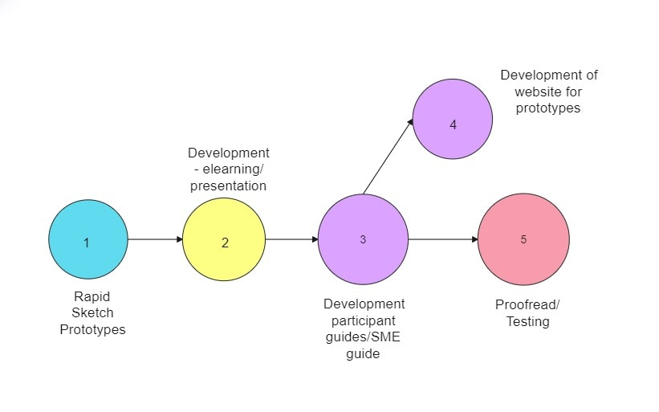
Group Allocations
[The PAL task to be completed by all groups]
OR
Topics to assign to each group:
[Group 1’s topic]
[Group 2’s topic]
[Group 3’s topic]
[Add additional groups/topics as necessary]

Slide 7
[Your Group Task]
Please modify as appropriate
[Describe the task below]
Example:
Your task must involve:
[Class]
[Mechanism]
[Efficacy]
[How to use it]
[Adverse effects]
[Constraints]

Slide 8

Group Roles (e.g. for 6 Students per Group)
Please modify as appropriate
Assign roles within your group to ensure smooth teamwork:
Lead Presenter
Delivers the main content
Ensures timing is kept
Evidence Lead
Checks accuracy
Ensures [UK‑relevant /insert region-specific] guidelines are used
Padlet Scribe
Posts your group’s contributions on Padlet
Summarises key points
Case Study Creator
Designs 1–2 realistic scenarios
Helps lead discussion
Communicator
Focuses on explanation
Ensures communication is clear and accessible
Q&A Lead
Answers questions from other groups
Reviews Padlet questions after your presentation

Slide 9
What Good Teamwork Looks Like
Everyone contributes
Roles are respected
Presentation is cohesive
Information is accurate and evidence‑based
Communication is clear and professional
Group supports each other during Q&A
[Any additional points deemed suitable by the facilitator]

Slide 10
Introduction to Padlet
Padlet will be used to:
Capture group takeaways
Ask questions
Provide peer feedback
Summarize and compare methods
You will post as a group, not individually.

Slide 11
How to Use Padlet (Step‑by‑Step)
Open the Padlet link or scan the QR code
Find your group’s column
Click the + button to add a post
Add a title (e.g. “Group 4 – Key Takeaway”)
Write your group’s response
Keep posts short and clear
You may add links, images, or files if helpful
[Facilitator: you may replace the example title with your own naming convention, provide additional instructions, or include screenshots to guide students. Ensure any bracketed instructions are removed before sharing with students.]

Slide 12
Warm‑Up Activity (Group Task)
In the Warm‑Up column, your group posts:
One thing your group already knows about the topic
One thing your group finds confusing
This helps identify misconceptions and guide discussion.
[Facilitator: you may add or modify instructions depending on the topic or learning objectives. Consider providing an example post for clarity. Ensure all bracketed text is removed before sharing with students.]

Slide 13

During Each Presentation
While another group presents, your group must post one Padlet entry in that group’s column:
Your post must include:
1 key takeaway
1 question
Your Padlet Scribe will type, but the whole group contributes idea
[Facilitator: you may adjust the number of questions or key takeaways depending on session time and group size. Ensure all bracketed instructions are removed before sharing with students.]

Slide 14
After Your Group Presents
Your group will:
Review the Padlet posts in your column
Select [insert number] questions to answer
Provide a brief, evidence‑based response
Your Q&A Lead and Communicator take the lead here.
[Facilitator: replace the bracketed text with the recommended number of questions for your session. Ensure any other bracketed instructions are removed before sharing.]

Slide 15
Final Group Task: Summary & Comparison
In the final Padlet column, your group posts: Please modify as appropriate
A 3–4 sentence summary of your method,
A student‑friendly explanation
One comparison with another approach, method, key idea, concept, argument, strategy, solution, or perspective, depending on the task ([eg,. efficacy, ease of use, risks, limitation, advantages])
This reinforces the ILOs on counselling and comparison.
[Facilitator: you may adjust the instructions or examples to match the session’s topic. Ensure all bracketed text is reviewed or removed before sharing with students.]

Slide 16
Example Padlet Post (Template)
Title: [Group 3 – Key Takeaway, Question, Scenario]
Key Takeaway: [One key idea we learned from today’s session is that understanding how concepts apply in real-world situations helps us better understand the topic]
Question: [One question we still have is: which part of this concept is most important when applying it in practice?]
Scenario: [For example, if this concept were applied in a real-world situation (such as a workplace, experiment, case study, or practical problem), how should it be used to make a decision or solve the issue?]
[Facilitator: replace all bracketed text with your session-specific example or leave as a template for students to edit. This slide demonstrates the format of a Padlet post for reference.]

Slide 17
Expectations for Professionalism
Respectful communication
Constructive feedback
Evidence‑based answers
Inclusive, patient‑centred language
No judgemental or biased statements
[Facilitator: you may add or modify points to reflect your session’s specific professionalism standards. Ensure all bracketed text is removed before sharing with students.]

Slide 18
Tips for Success
Keep slides simple and visual
Practise timing
[Add any other tips relevant to your session]
[Facilitator: you may add or remove tips based on session objectives or student needs. Ensure all bracketed text is reviewed before sharing with students.]

Slide 19
Questions or Clarifications

